Slide 1
Pre-Earthquake Preliminary Seismic Safety Assessment: Timisoara Case Study
Mustafa Kutanis, Sakarya University, TR
IMPROVING THE QUALITY OF SUBURBAN BUILDING STOCKS
COST ACTION TU0701
INTERNATIONAL FINAL CONFERENCE
20th-21th April 2012

Slide 2
Outline
Need for Seismic Assessment
Assessment procedures
  Preliminary Assessment Methods
Timisoara Case Study
  Seismicity study
  Geotecnical Investigation
  Earthquake demand
  Investigation on the case study building
  P25 ver.2 Application
  Discussion
Notes:
The main objective of the Action is the development and dissemination of knowledge and tools to assess and promote the refurbishment of existing suburban building stocks.Suburban building estates make up more than 50 of all European Urban Heritage. Most of the buildings generally multi-family housing blocks consisting of small apartments were completed after 1950 using low-cost technologies and are often characterized by very poor quality, which contributes to the social decay of suburbs. The aim of the Action is to investigate, compare, define and disseminate common knowledge concerning methods, procedures and technologies for: - the renovation and revitalization of suburban housing settlements, - increasing their value, and - improving safety and the quality of life of inhabitants. The approach is based on a concept of Quality which incorporates a multitude of factors including energy efficiency, accessibility, sustainability and multi-functionality of buildings. On the other hand, quality standards must be improved in order to satisfy user needs as regards comfort, safety and accessibility, as well as the new European regulations concerning sustainability and energy savings. In order to achieve these objectives, new specific social, financial, technical and procedural models must be developed to facilitate the decisions of local authorities, housing corporations, owners and designers. A relevant number of representative case studies from the countries involved in the Action will be analyzed to test and validate the results achieved.Keywords: Suburban Areas, Building Quality, Housing Stock Improvement and Renovation, Sustainable Development, Energy Efficiency, Quality of Life, Safety of Citizens, Accessibility, Social Integration, Employment Opportunities.

Slide 3
Need for Seismic Assessment (?)
Earthquake engineering profession has been changing greatly since 1950’s in such a way that
Seismic input database - instrumentation
Seismicity of the world
Improve computational techniques
Lessons learned from past Eqs
Considerable research studies are implemented

Slide 4
Do we really need such a work, in TU0701?
Research reveals that in many strong earthquakes older postwar multi-family housing structures may cause much more casualties and damages than new structures.
Because, in most seismic regions of the world, older buildings, originally built with inadequate seismic resistance, constitute by far the largest risk of economic and life safety losses
Therefore, during the refurbishment process, the assessment of the seismic capacity of existing structures and prioritization for strengthening must be evaluated.

Slide 5
Assessment procedures
Pre-earthquake assessment can be performed with many levels and for many different purposes, ranging from estimates of probable loss to inventories by insurance companies, to classification of risk by building classes, to detailed analysis of single buildings.
Post-earthquake evaluation is the safety of buildings against further shocks. Since citizens are not usually able to evaluate the residual building strength and as the number of buildings to be inspected is very huge, safety inspections are usually managed by proper institutions. Inspectors have to balance the safety of citizens, since once the building is judged safe, people will keep living there, against the need to reduce peoples’ discomfort.
Notes:
Pre EQ: to prevent life loss and economic loss, for the future earthquake
Post EQ :

Slide 6
Pre-earthquake assessment
  Rapid Visual Screening Methods
  For large-scale (national) applications, the acquisition and analysis methodologies must be compatible with a little amount of data, and the swiftness of the procedures is an indispensable requirement
  Preliminary Assessment Methods
  For medium-scale (regional) applications, the acquisition and analysis methodologies can be supported by a more consistent amount of data and procedures can be more refined, even if still simple
  Detailed Evaluation Methods
  For small-scale (local) applications, the acquisition and analysis methodologies must be very accurate because single objects (a single bridge, or building) are considered
Notes:
Swiftnes : süratli, hızlı bir şekilde
İndispensible: kaçınılmaz, zaruri
Rapid: street walking method

Slide 7
  Preliminary Assessment Methods
Method requires entry to the building (!) and review of drawings (!).
No sophisticated and time-consuming calculations, but some quick calculations are performed.
The structural capacity is expressed in terms of an index, which is checked against an anticipated demand.
The success of these techniques depends on the availability and quality of data
Notes:
Critical story -> ground floor
Anticipated : sezilen, beklenen
anticipated deamnd: muhtemel deprem talebi ile (future eqs)

Slide 8
P25-v2 : Preliminary assessment method (1/2)
25 different structural features of the investigated buildings which are either measured or observed visually and then the building performance score is determined by means of simple excel spreadsheet calculations.
Parameters:
X-sectional dimensions of RC columns, SW, and infill walls at the critical floor, which is usually the basement or ground floor
Story heights and the total height
Outer plan dimensions of ground floor
Typical beam dimensions

Slide 9
(2/2)
Effective ground acceleration → CODE
Building importance factor → CODE
Soil conditions/ profile → Geotechnical investigation
Other observational or measurable parameters like material quality, confinement zones of columns, pounding effect, topographic conditions, various structural irregularities such as, short columns, torsion, soft story, frame discontinuity, etc

Slide 10
TIMISOARA CASE STUDY
Seismicity study
Geotecnical Investigation
Earthquake demand determination
Investigation on the case study building
P25 ver.2 Application
Discussion

Slide 11
Seismicity
In the Romanian territory, Timisoara located at Banat Seismic Region at the western part of the Romania
Historical information suggests potential earthquakes greater than 6 in Crisana-Maramures (NW of Romania), but only one event approaching magnitude 5 was reported in this century
The largest earthquake occurred after 1900 is the one from July 12, 1991, with a magnitude of M_{L} 5.7 at 11 km depth
The largest reported earthquake was Mw 6.5 on October 15, 1834
In addition, a great destructive earthquake was situated in Timisoara in 1443
Notes:
EQs experienced in the past will repeat itself in the future.

Slide 12
Geotecnical Investigation (1/3)
Rock
Fault
Building Site
Soil
Motion can be amplified by Soil conditions (Site Response)
Seismic waves lengthen and diminish in strength as they travel away from the epicenter (Attenuate).
(After Craig D. Comartin)

Slide 13
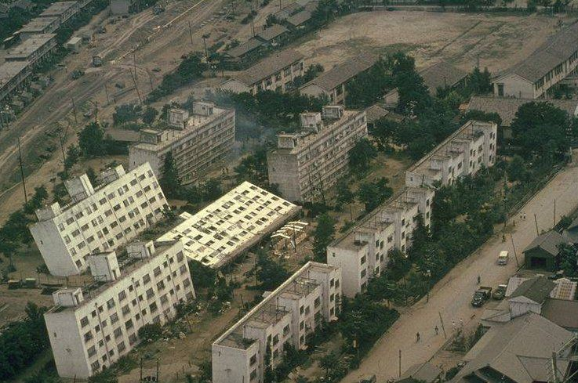
Liquefaction (2/3)
Sand
High GWT
Strong Shaking
Long Duration

Slide 14
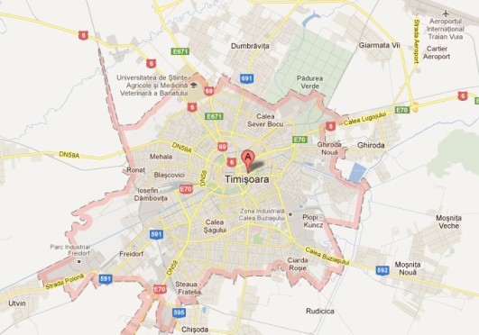
Timisoara Geotecnical Investigation (3/3)
There are at least two types of soil layers in the City.
In the South: Silty sands and fine and medium sands are available. 6m thickness.
In the North: Silty clay prevails. 6m to 8m.
The ground stratification on the Reabilitarea Building area is silty clays with 8m bedrock depth.
GWT changes in btw 1.0m and 2.30m varying with the season.

Slide 15
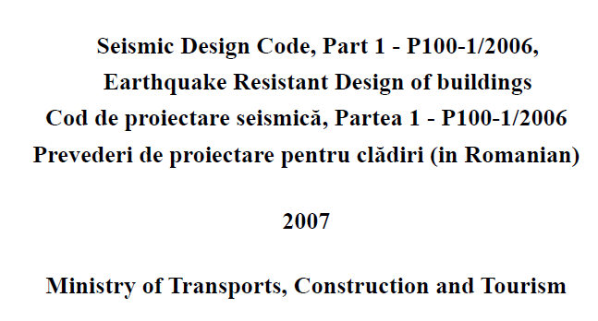
Earthquake Demand

Slide 16
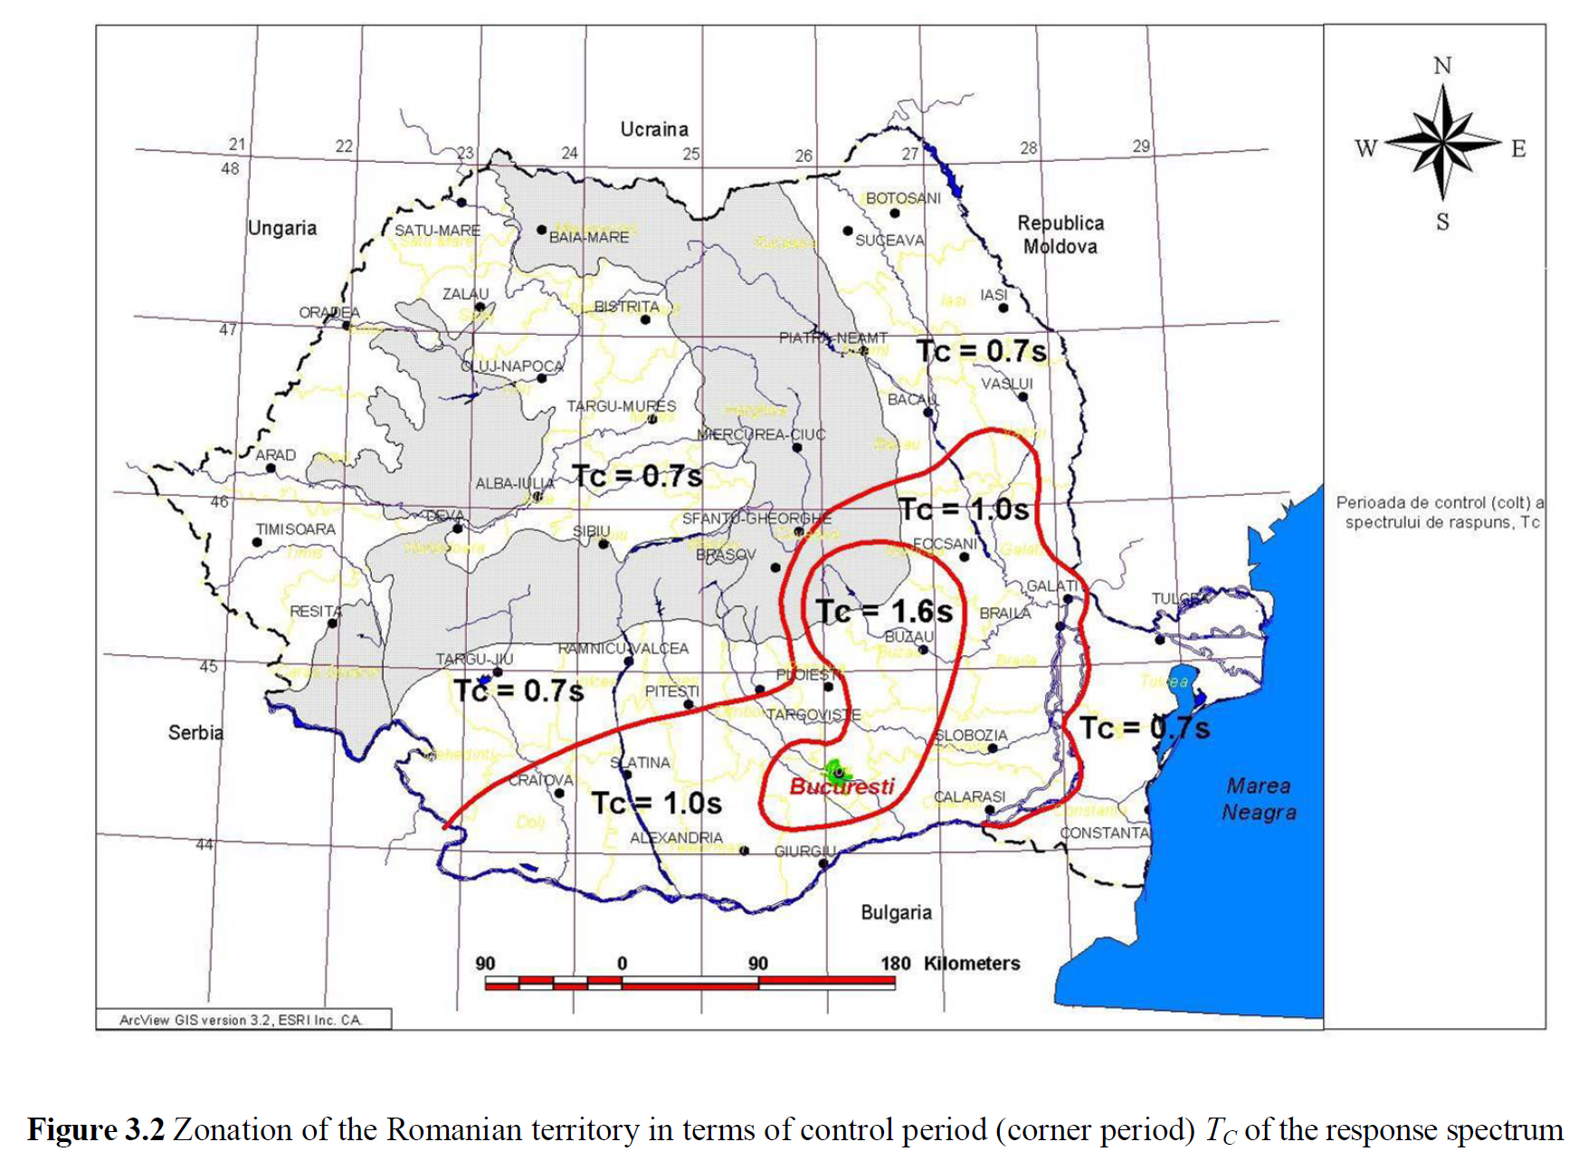
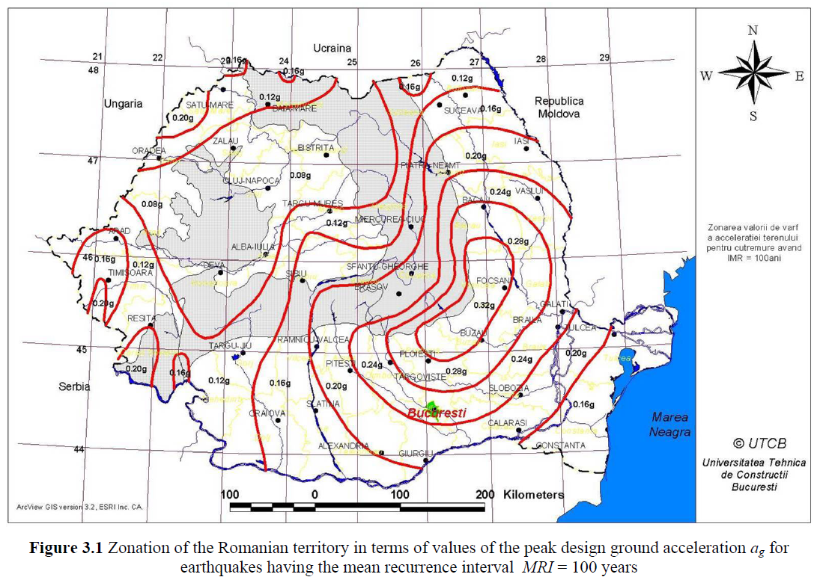
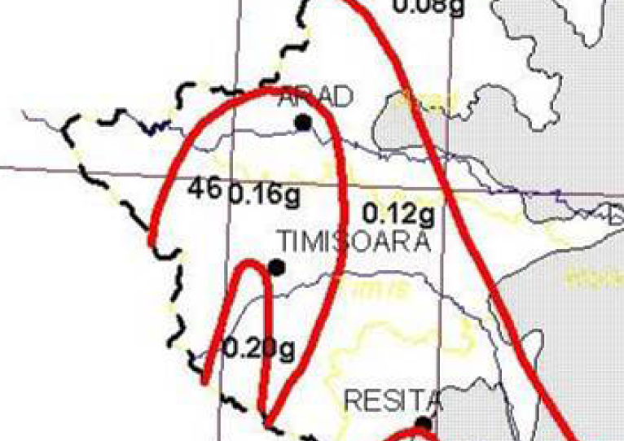

Slide 17
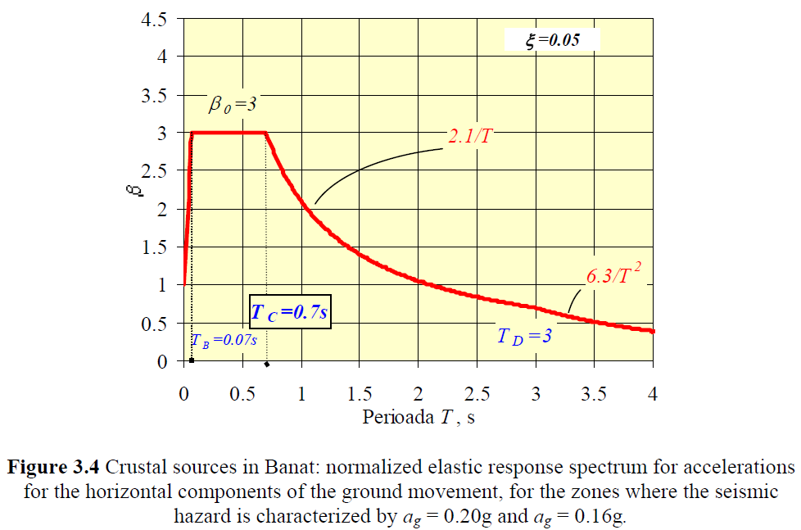
Notes:
Romanian Seismic code rule this spectra

Slide 18
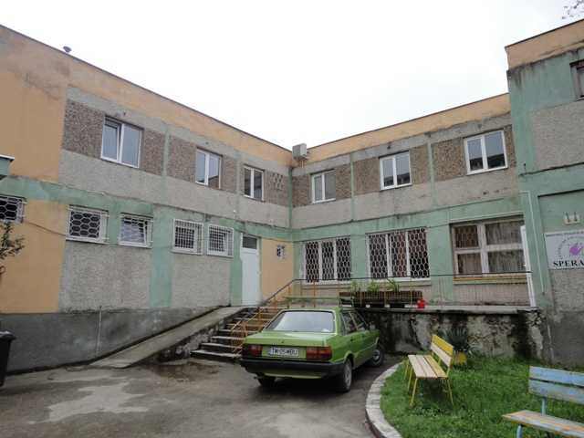
Investigation on the case study building
Reabilitarea Building is a 2-story RC infill panel structure with non-symmetrical around both y- axis and x-axis.

Slide 19
P25 ver.2 Method Summary (1/2)
7 different failure criteria & their interactions are considered
P1 is related to the basic structural characteristics (i.e., column and wall area & inertia ratios, material prop., irregularities, etc.)
P2 is short-column induced mechanism, decided acc. to the short-column length & the level of occurrence of short columns at the critical floor
P3 is soft- and/or weak-story mechanism which is determined by the difference in succeeding story heights and strengths
P4 includes possible weaknesses due to over-hanged upper floors and lack of perimeter beams which causes frame discontinuity
P5 failure mode is based on the pounding effect induced by the adjacent structures
P6 and P7 are related to liquefaction and other soil failures, respectively.

Slide 20
P25 ver.2 Method Summary (2/2)
Final performance scores are graded between 0 and 100, varying from the worst to the best, respectively.
Recent studies on some hundreds of buildings show that the high risk band is between the scores of 15 and 40 and the performance score of 30 can then be considered as the safety-limit.
Buildings within the high risk band are strongly recommended to be assessed in detail by expert engineers

Slide 21
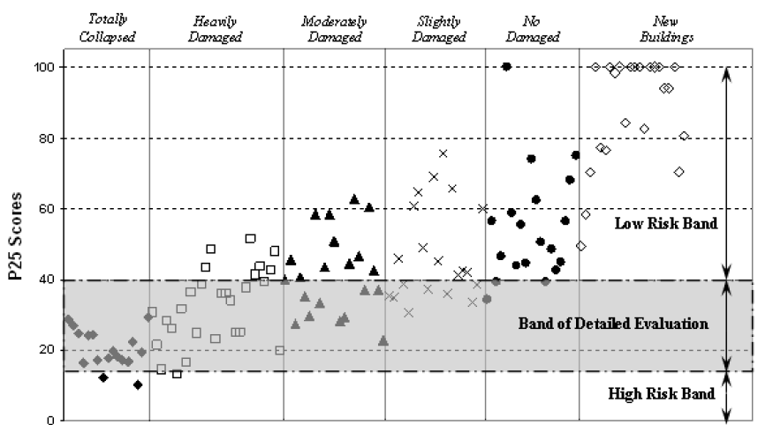

Slide 22
Discussion
Applying P25-v2 on the Reabilitarea Building, a final performance scores P = 19 have been obtained which is within the high risk band and also below the suggested safety limit of 30.
The Reabilitarea Building score revealing the fact that the building is at critical level in terms of seismic safety so it must be analyzed in detail by expert engineers.
It is worth mentioning that If the soil conditions were good; (related to no liquefaction and other soil failures), a final performance score would be as P = 40, being just over the high risk band.

Slide 23
THANK YOU
?

